Slide 1
Routers

Slide 2
Some Questions
What is a router?
Can a PC be a router?
  How far can it scale?
What is done in software vs. hardware?
  Trade-offs in speed vs. flexibility
What imposes limits on scaling?
  Bit rate? Number of IP prefixes? # of line cards?
Where should the memory go?
  How much memory space should be available?

Slide 3
What is a Router?
A computer with…
  Multiple interfaces
  Implementing routing protocols
  Packet forwarding
Wide range of variations of routers
  Small Linksys device in a home network
  Linux-based PC running router software
  Million-dollar high-end routers with large chassis
… and links
  Serial line, Ethernet, WiFi, Fiber, …

Slide 4
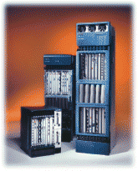
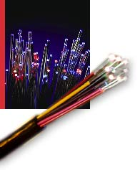
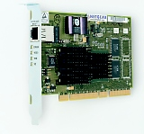
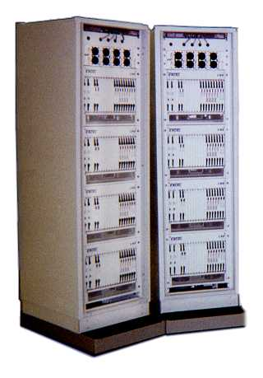
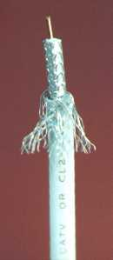
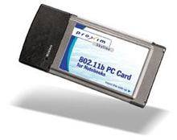
Network Components
Links
Line cards
Routers/switches
Fibers
Ethernet card
Large router
Wireless card
Coaxial Cable
Telephone
switch

Slide 5
Routers: Commercial Realities
A router is sold as one big box
  Cisco, Juniper, Redback, Avici, …
  No standard interfaces between components
  Cisco switch, Juniper cards, and Avici software?
Vendors vs. service providers
  Vendors: build the routers and obey standards
  Providers: buy the routers and configure them
Some movement now away from this
  Open source routers on PCs (Quagga, Vyatta, …)
  Hardware standards for components
  Vendors opening router platforms to third-party developers

Slide 6
Inside a High-End Router
Processor
Switching
Fabric
Line card
Line card
Line card
Line card
Line card
Line card

Slide 7
Switch Fabric
Data
1
1
Hdr
Header Processing
Queue
Packet
Lookup
IP Address
Update
Header
Address
Table
Buffer
Memory
Data
2
2
N times line rate
Hdr
Header Processing
Queue
Packet
Lookup
IP Address
Update
Header
Address
Table
Buffer
Memory
N times line rate
Data
Hdr
Header Processing
N
N
Queue
Packet
Lookup
IP Address
Update
Header
Address
Table
Buffer
Memory

Slide 8

Switch Fabric: Three Design Approaches

Slide 9
Switch Fabric: First Generation Routers
Traditional computers with switching under direct control of the CPU
Packet copied to the system’s memory
Speed limited by the memory bandwidth (two bus crossings per packet)
Input
Port
Memory
Output
Port
System Bus

Slide 10
Switch Fabric: Switching Via a Bus
Packet from input port
memory to output port
memory via a shared bus
Bus contention: switching speed
limited by bus bandwidth
1 Gbps bus, Cisco 1900: sufficient speed for access and enterprise
routers (not regional or backbone)

Slide 11
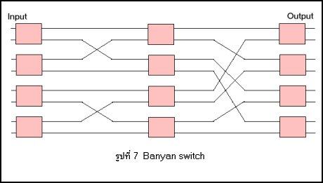
Switch Fabric: Interconnection Network
Banyan networks, other interconnection nets initially created for multiprocessors
Advanced design: fragmenting packet into fixed length cells to send through the fabric
Cisco 12000: switches Gbps through the interconnection network

Slide 12

Buffer Placement: Output Port Queuing
Buffering when the aggregate arrival rate exceeds the output line speed

Slide 13

Buffer Placement: Input Port Queuing
Fabric slower than input ports combined
  So, queuing may occur at input queues
Head-of-the-Line (HOL) blocking
  Queued packet at the front of the queue prevents others in queue from moving forward

Slide 14
Buffer Placement: Design Trade-offs
Output queues
  Pro: work-conserving, so maximizes throughput
  Con: memory must operate at speed N*R
Input queues
  Pro: memory can operate at speed R
  Con: head-of-line blocking for access to output
Work-conserving: output line is always busy when there is a packet in the switch for it
Head-of-line blocking: head packet in a FIFO cannot be transmitted, forcing others to wait

Slide 15
Buffer Placement: Virtual Output Queues
Hybrid of input and output queuing
  Queues located at the inputs
  Dedicate FIFO for each output port
Switching
Fabric
Output port #1
Output port #2
Output port #3
Input port #1
Output port #4

Slide 16
Line Cards
Interfacing
  Physical link
  Switching fabric
Packet handling
  Packet filtering (ACLs)
  Packet forwarding (FIB)
  Buffer management
  Link scheduling
  Rate-limiting
  Packet marking
  Measurement
to/from link
Receive
FIB
Transmit
to/from switch
Notes:
Forwarding Information Base

Slide 17
Line Cards: Packet Filtering With ACLs
Should arriving packet be allowed in? Departing packet let out?
“Five tuple” for access control lists (ACLs)
  Source and destination IP addresses
  Source and destination ports
  Protocol (e.g., UDP vs. TCP)

Slide 18
Line Cards: ACL Examples
Filter packets based on source address
  Customer access link to the service provider
  Source address should fall in customer prefix
Filter packets based on port number
  Block traffic for unwanted applications
  Known security vulnerabilities, peer-to-peer, …
Block pairs of hosts from communicating
  Protect access to special servers
  E.g., block the student Lab computers from the exam server ☺

Slide 19
Line Cards: Longest-Prefix Match Forwarding
Forwarding Information Base in IP routers
  Maps each IP prefix to next-hop link(s)
Destination-based forwarding
  Packet has a destination address
  Router identifies longest-matching prefix
  Pushing complexity into forwarding decisions
FIB
4.0.0.0/8
4.83.128.0/17
12.0.0.0/8
12.34.158.0/24
126.255.103.0/24
destination
12.34.158.5
outgoing link
Serial0/0.1

Slide 20
Line Cards: Simplest Algorithm is Too Slow
Scan the forwarding table one entry at a time
  See if the destination matches the entry
  If so, check the size of the mask for the prefix
  Keep track of entry with longest-matching prefix
Overhead is linear in size of forwarding table
  Today, that means ~300,000 entries!
  And, the router may have just a few nanoseconds
  … before the next packet is arriving
Need to be able to keep up with line rate
  Better algorithms
  Hardware implementations

Slide 21
Line Cards: Patricia Tree
Store the prefixes as a tree
  One bit for each level of the tree
  Some nodes correspond to valid prefixes
  ... which have next-hop interfaces in a table
When a packet arrives
  Traverse tree based on the destination address
  Stop upon reaching the longest matching prefix
0
1
00
10
11
0*
00*
100
101
11*

Slide 22
Line Cards: Even Faster Lookups
Patricia tree is faster than linear scan
  Proportional to number of bits in the address
Can use special hardware
  Content Addressable Memories (CAMs)
  Allows look-ups on a key rather than flat address
Huge innovations in the mid-to-late 1990s
  After CIDR (class-less inter-domain routing) was introduced (in 1994)

Slide 23
Line Cards: Packet Forwarding Evolution
Software on the router CPU
  Central processor makes forwarding decision
  Not scalable to large aggregate throughput
Route cache on the line card
  Maintain a small FIB cache on each line card
  Store (destination, output link) mappings
  Cache misses handled by the router CPU
Full FIB on each line card
  Store the entire FIB on each line card
  Apply dedicated hardware for longest-prefix match

Slide 24


Line Cards: FIFO Link Scheduler
First-in first-out scheduling
  Simple to implement
  But, restrictive in providing predictable performance
Example: two kinds of traffic
  Audio conferencing needs low delay (e.g., sub 100 msec)
  E-mail transfers are not that sensitive about delay
FIFO mixes all the traffic together
  E-mail traffic interferes with audio conference traffic

Slide 25
Line Cards: Strict Priority Schedulers
Strict priority
  Multiple levels of priority
  Always transmit high-priority traffic, when present
  .. and force the lower priority traffic to wait
Isolation for the high-priority traffic
  Almost like it has a dedicated link
  Except for (small) delay for packet transmission

Slide 26
Line Cards: Weighted Link Schedulers
Limitations of strict priority
  Lower priority queues may starve for long periods
  … even if high-priority traffic can afford to wait
Weighted fair scheduling
  Assign each queue a fraction of the link bandwidth
  Rotate across the queues on a small time scale
  Send extra traffic from one queue if others idle
50% red, 25% blue, 25% green

Slide 27
Line Cards: Link Scheduling Trade-Offs
FIFO is easy
  One queue, trivial scheduler
Strict priority is a little harder
  One queue per class of traffic, simple scheduler
Weighted fair scheduling
  One queue per class, and more complex scheduler
How many classes?
  Gold, silver, bronze traffic?
  Per UDP or TCP flow?

Slide 28
Line Cards: Mapping Traffic to Classes
Gold traffic
  All traffic to/from XYZ IP address
  All traffic to/from the port number for DNS
Silver traffic
  All traffic to/from academic and administrative buildings
Bronze traffic
  All traffic on the public wireless network
Then, schedule resources accordingly
  50% for gold, 30% for silver, and 20% for bronze

Slide 29
Line Cards: Packet Marking
Where to classify the packets?
  Every hop?
  Just at the edge?
Division of labor
  Edge: classify and mark the packets
  Core: schedule packets based on markings
Packet marking
  Type-of-service bits in the IP packet header

Slide 30
Line Cards: Real Guarantees?
It depends…
  Must limit volume of traffic marked as gold
  E.g., by marking traffic “bronze” by default
  E.g., by policing traffic at the edge of the network
QoS through network management
  Configuring packet classifiers
  Configuring link schedulers

Slide 31
Line Cards: Traffic Measurement
Measurements are useful for many things
  Billing the customer
  Engineering the network
  Detecting malicious behavior
Collecting measurements at line speed
  Byte and packet counts on the link
  Byte and packet counts per prefix
  Packet sampling
  Statistics for each TDP or UDP flow

Slide 32
Route Processor
So-called “Loopback” interface
  IP address of the CPU on the router
Control-plane software
  Implementation of the routing protocols
  Creation of forwarding table for the line cards
Interface to network administrators
  Command-line interface for configuration
  Transmission of measurement statistics
Handling of special data packets
  Packets with expired Time-To-Live field

Slide 33
Data, Control, and Management Planes
 | Data Plane | Control Plane | Management Plane
Timescale | Packet (nsec) | Event (10 msec to sec) | Human (min to hours)
Tasks | Forwarding, buffering, filtering, scheduling | Routing, signaling | Analysis, configuration
Location | Line-card hardware, switch fabric | Software on the route processor | Humans or scripts

Slide 34
Click Modular Router

Slide 35
Click Motivation
Flexibility
  Add new features
  Enable experimentation
Openness
  Allow users/researchers to build and extend
  (In contrast to most commercial routers)
Modularity
  Simplify the composition of existing features
  Simplify the addition of new features
Speed/efficiency
  Operation (optionally) in the operating system
  Without the user needing to grapple with OS internals

Slide 36
Router as a Graph of Elements
Large number of small elements
  Each performing a simple packet function
  E.g., IP look-up, TTL decrement, buffering
Connected together in a graph
  Elements inputs/outputs snapped together
  Beyond elements in series to a graph
  E.g., packet duplication or classification
Packet flow as main organizational primitive
  Consistent with data-plane operations on a router
  (Larger elements needed for, say, control planes)

Slide 37
Click Elements: Push vs. Pull
Packet hand-off between elements
  Directly inspired by properties of routers
  Annotations on packets to carry temporary state
Push processing
  Initiated by the source end
  E.g., when an unsolicited packet arrives (e.g., from a device)
Pull processing
  Initiated by the destination end
  E.g., to control timing of packet processing (e.g., based on a timer or packet scheduler)

Slide 38
Click Language
Declarations
  Create elements
Connections
  Connect elements
Compound elements
  Combine multiple smaller elements, and treat as single, new element to use as a primitive class
Language extensions through element classes
  Configuration strings for individual elements
  Rather than syntactic extensions to the language
src :: FromDevice(eth0);
ctr :: Counter;
sink :: Discard;
src -> ctr;
ctr -> sink;

Slide 39
Handlers and Control Socket
Access points for user interaction
  Appear like files in a file system
  Can have both read and write handlers
Examples
  Installing/removing forwarding-table entries
  Reporting measurement statistics
  Changing a maximum queue length
Control socket
  Allows other programs to call read/write handlers
  Command sent as single line of text to the server
  http://read.cs.ucla.edu/click/elements/controlsocket?s=llrpc

Slide 40
Example: EtherSwitch Element
Ethernet switch
  Expects and produces Ethernet frames
  Each input/output pair of ports is a LAN
  Learning and forwarding switch among these LANs
Element properties
  Ports: any # of inputs, and same # of outputs
  Processing: push
Element handlers
  Table (read-only): returns port association table
  Timeout (read/write): returns/sets TIMEOUT
http://read.cs.ucla.edu/click/elements/etherswitch

Slide 41
An Observation…
Click is widely used
  And the paper on Click is widely cited
Click elements are created by others
  Enabling an ecosystem of innovation
Take-away lesson
  Creating useful systems that others can use and extend has big impact in the research community
  And brings tremendous professional value
  Compensating amply for the time and energy ☺

